Slide 1

Chapter 28 Weighted Graphs and Applications

Slide 2
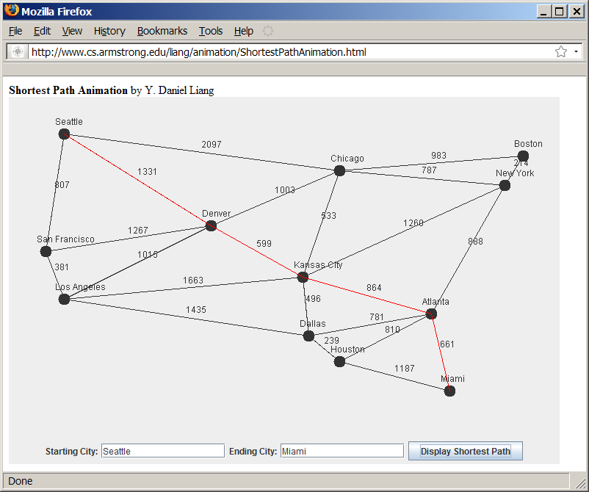
Weighted Graph Animation
www.cs.armstrong.edu/liang/animation/ShortestPathAnimation.html

Slide 3
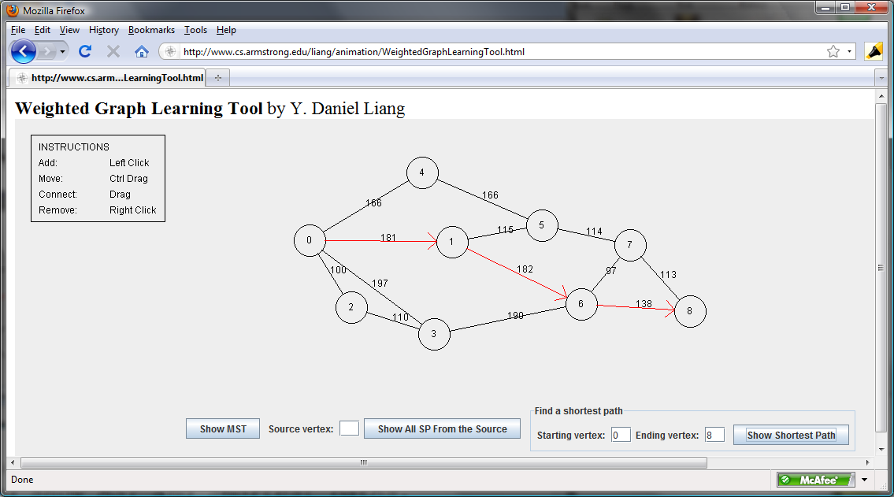
Weighted Graph Animation
www.cs.armstrong.edu/liang/animation/WeightedGraphLearningTool.html

Slide 4
Objectives
To represent weighted edges using adjacency matrices and priority queues (§28.2).
To model weighted graphs using the WeightedGraph class that extends the AbstractGraph class (§28.3).
To design and implement the algorithm for finding a minimum spanning tree (§28.4).
To define the MST class that extends the Tree class (§28.4).
To design and implement the algorithm for finding single-source shortest paths (§28.5).
To define the ShortestPathTree class that extends the Tree class (§28.5).
To solve the weighted nine tail problem using the shortest path algorithm (§28.6).

Slide 5
Representing Weighted Graphs
Representing Weighted Edges: Edge Array
Weighted Adjacency Matrices
Priority Adjacency Lists

Slide 6
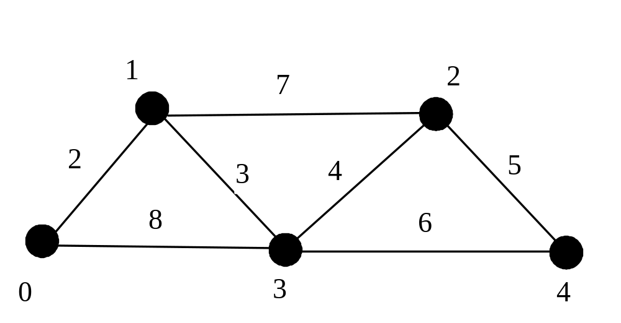
Representing Weighted Edges: Edge Array
int[][] edges = {{0, 1, 2}, {0, 3, 8},
{1, 0, 2}, {1, 2, 7}, {1, 3, 3},
{2, 1, 7}, {2, 3, 4}, {2, 4, 5},
{3, 0, 8}, {3, 1, 3}, {3, 2, 4}, {3, 4, 6},
{4, 2, 5}, {4, 3, 6}
};

Slide 7
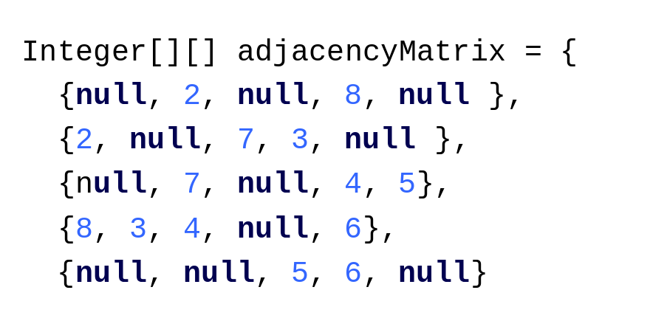
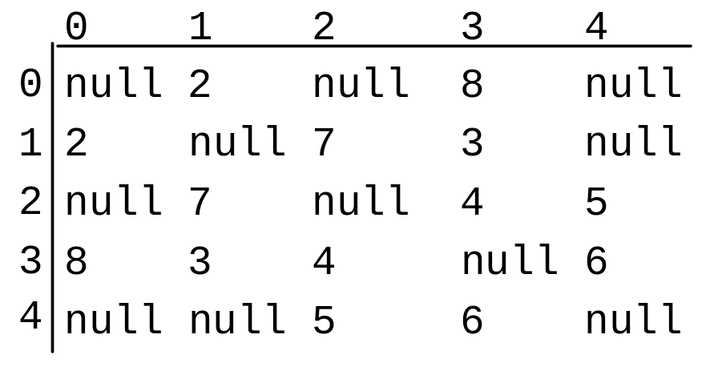
Representing Weighted Edges: Edge Array

Slide 8
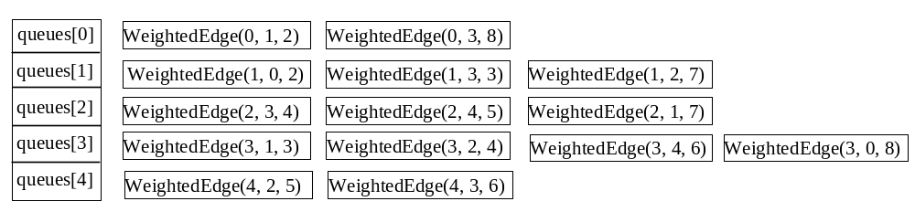
Priority Adjacency Lists

Slide 9
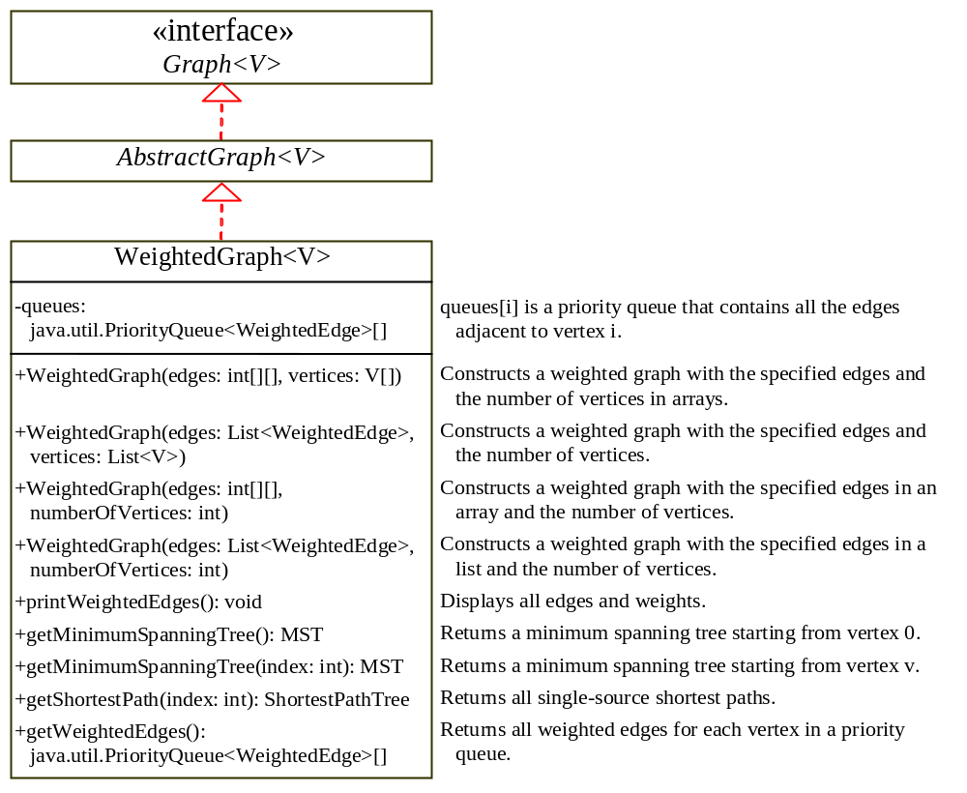
TestWeightedGraph
TestWeightedGraph
Graph
AbstractGraph
WeightedGraph

Slide 10
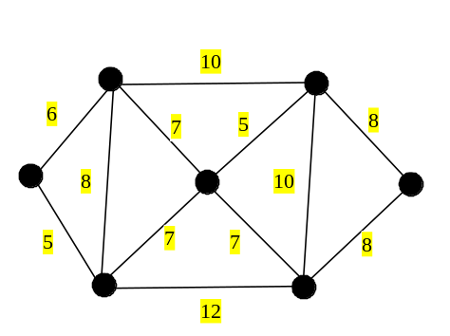
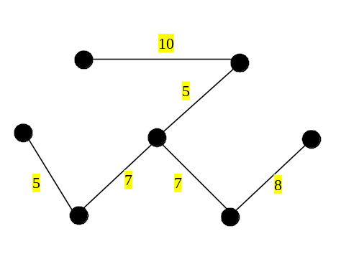
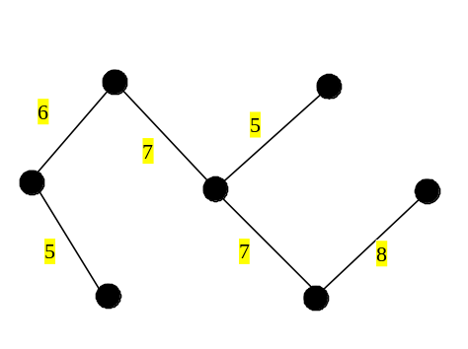
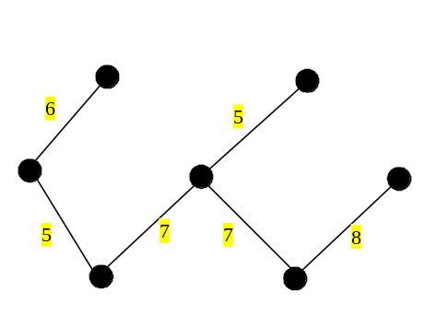
Minimum Spanning Trees
A graph may have many spanning trees. Suppose that the edges are weighted. A minimum spanning tree is a spanning tree with the minimum total weights. For example, the trees in Figures 28.3(b), 28.3(c), 28.3(d) are spanning trees for the graph in Figure 28.3(a). The trees in Figures 28.3(c) and 28.3(d) are minimum spanning trees.

Slide 11
Minimum Spanning Tree Algorithm
minimumSpanningTree() {
Let V denote the set of vertices in the graph;
Let T be a set for the vertices in the spanning tree;
Initially, add the starting vertex to T;
while (size of T < n) {
find u in T and v in V – T with the smallest weight
on the edge (u, v), as shown in Figure 28.4;
add v to T;
}
}

Slide 12
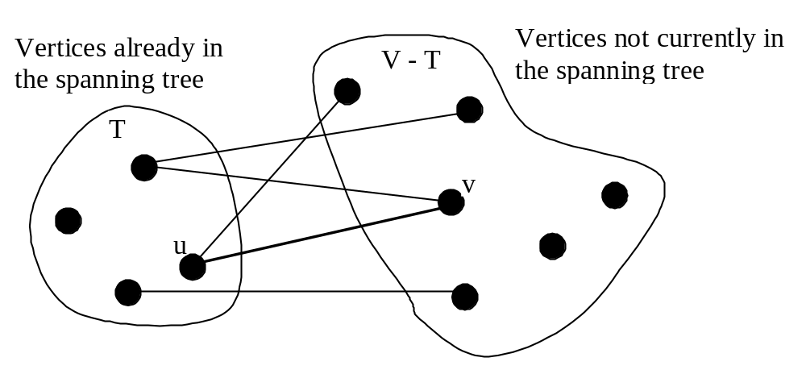
Minimum Spanning Tree Algorithm

Slide 13
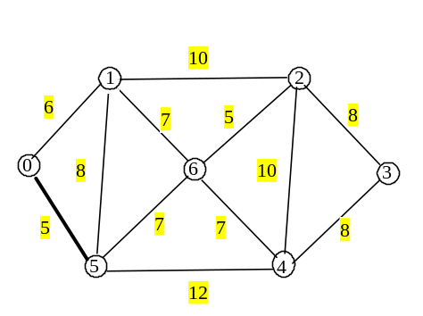
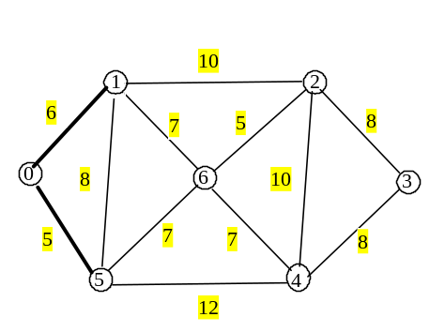
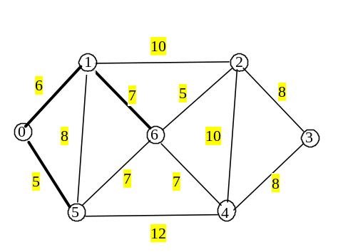
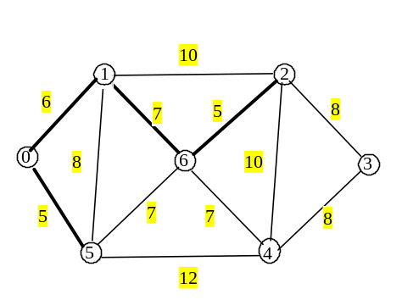
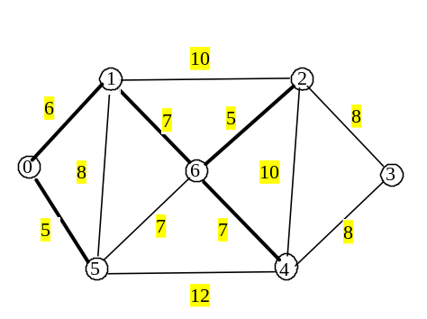
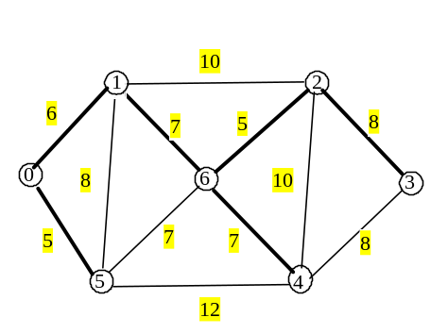
Minimum Spanning Tree Algorithm Example

Slide 14
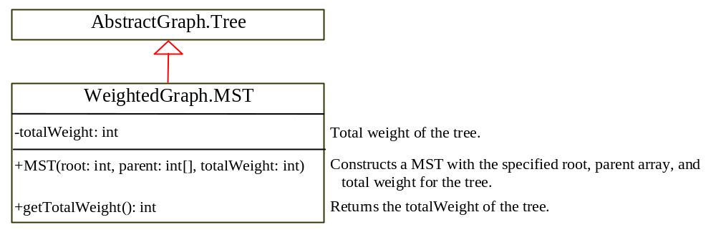
Implementing MST Algorithm

Slide 15
Time Complexity
For each vertex, the program constructs a priority queue for its adjacent edges. It takes O(log|V|) time to insert an edge to a priority queue and the same time to remove an edge from the priority queue. So the overall time complexity for the program is O(|E|log|V|) , where |E| denotes the number of edges and |V| denotes the number of vertices.

Slide 16
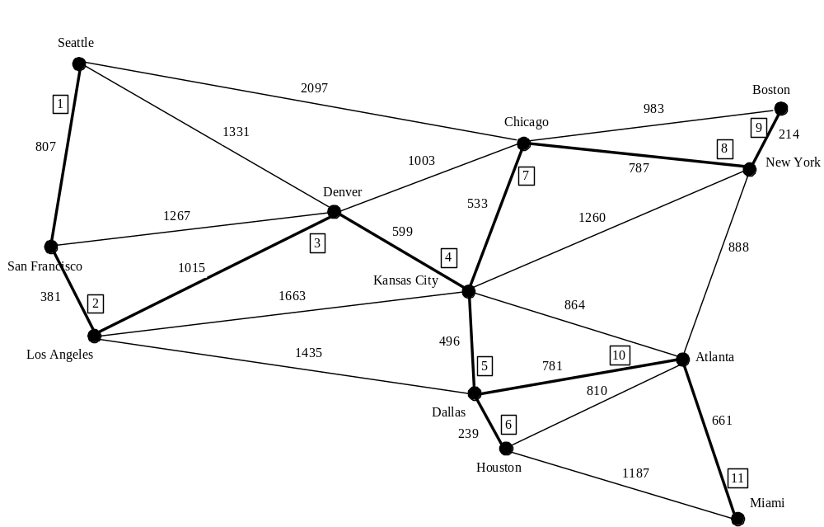
Test MST
TestMinimumSpanningTree
TestMinimumSpanningTree

Slide 17
Shortest Path
§27.1 introduced the problem of finding the shortest distance between two cities for the graph in Figure 13.1. The answer to this problem is to find a shortest path between two vertices in the graph.

Slide 18
Single Source Shortest Path Algorithm
shortestPath(s) {
Let V denote the set of vertices in the graph;
Let T be a set that contains the vertices whose
path to s have been found;
Initially T contains source vertex s;
while (size of T < n) {
find v in V – T with the smallest costs[u] + w(u, v) value
among all u in T;
add v to T;
}
}

Slide 19
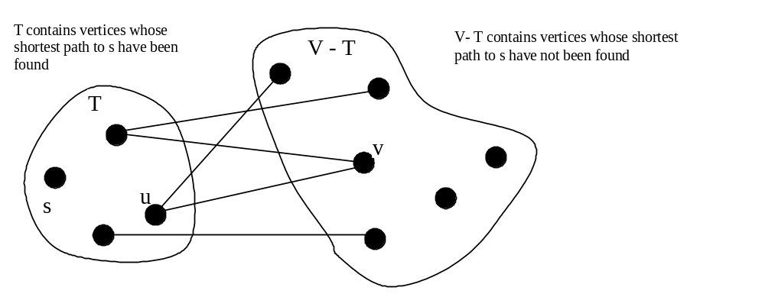
Single Source Shortest Path Algorithm

Slide 20
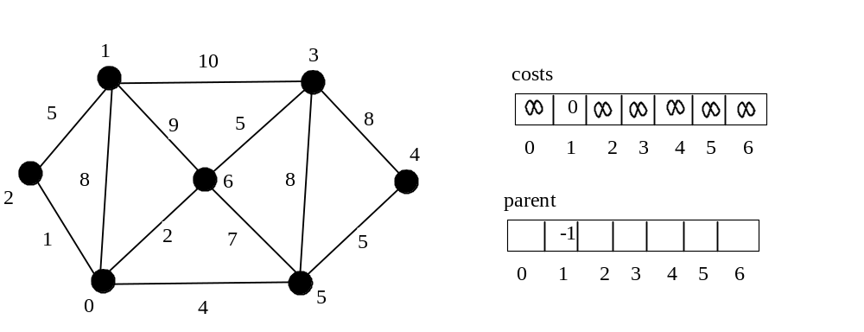
SP Algorithm Example

Slide 21
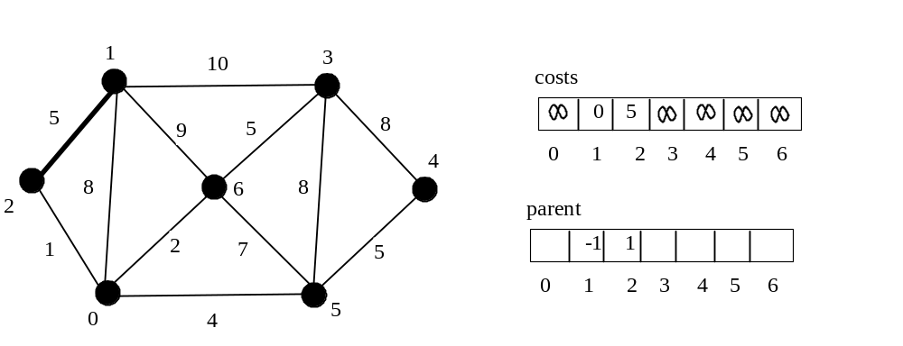
SP Algorithm Example

Slide 22
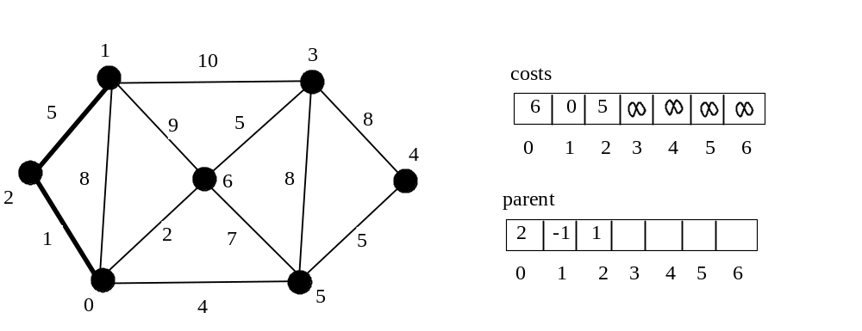
SP Algorithm Example

Slide 23
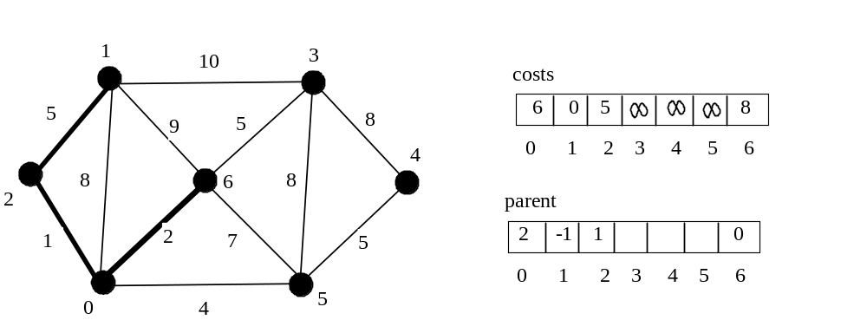
SP Algorithm Example

Slide 24
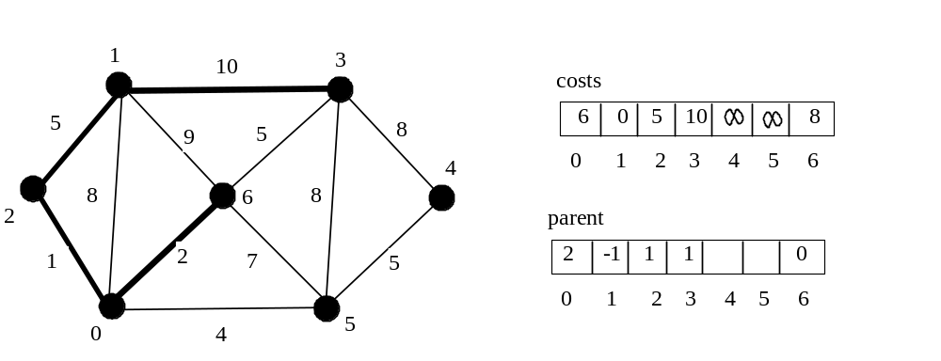
SP Algorithm Example

Slide 25
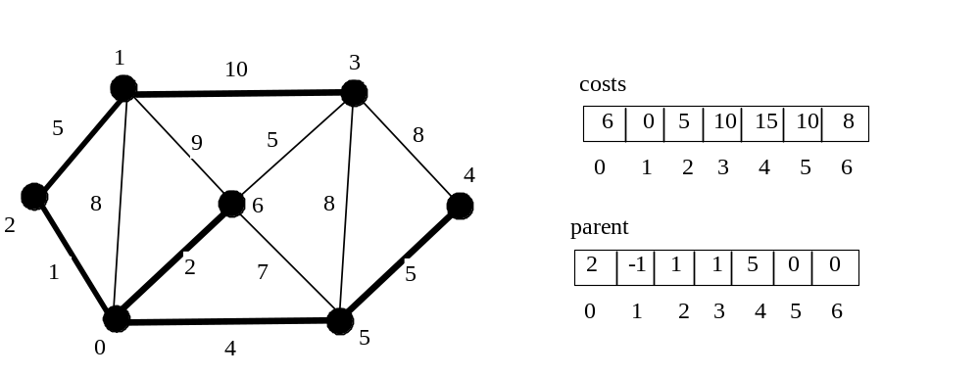
SP Algorithm Example

Slide 26
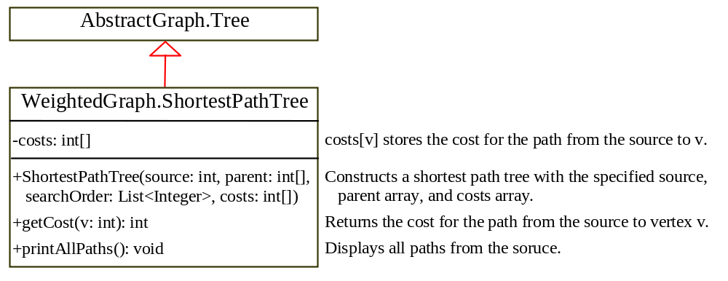
SP Algorithm Implementation
TestShortestPath
TestShortestPath

Slide 27
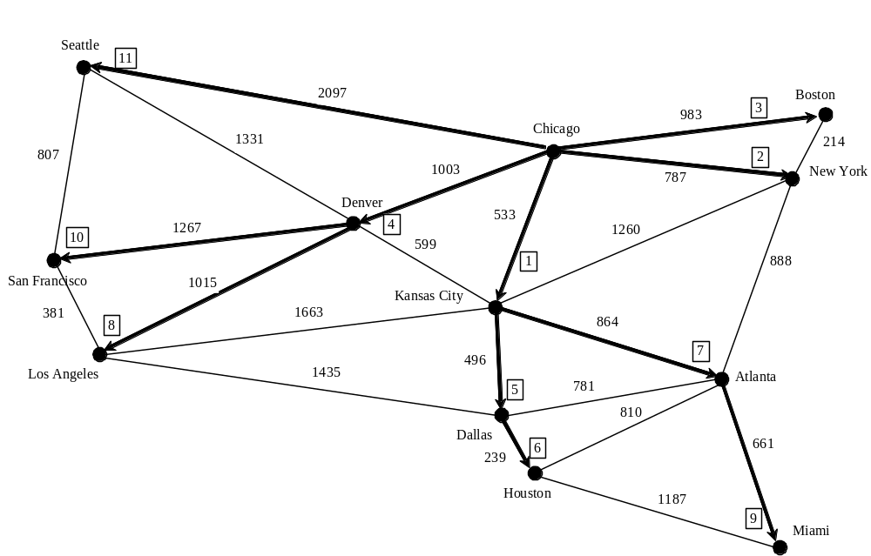
SP Algorithm Example

Slide 28
Shortest Path Animation
www.cs.armstrong.edu/liang/animation/ShortestPathAnimation.html

Slide 29
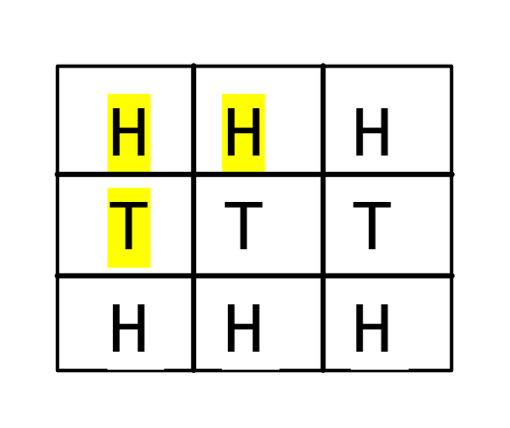
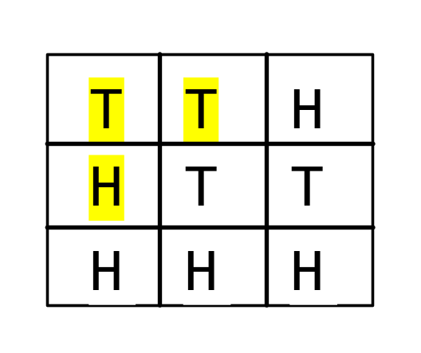
The Weighted Nine Tail Problem
The nine tail problem is to find the minimum number of the moves that lead to all coins face down. Each move flips a head coin and its neighbors. The weighted nine tail problem assigns the number of the flips as a weight on each move. For example, you can move from the coins in Figure 28(a) to Figure 28(b) by flipping the three coins. So the weight for this move is 3.
WeightedNineTailModel

